Slide 1
CMPE 180C Operating Systems
Final Project Presentation
Group Members: Debasish Panigrahi [015702414]
Gaurav Sarkar [016197857]
Romit Ganjoo [016054038]

Slide 2
Problem Statement
Write a multithreaded sorting program that works as follows: A list of integers is divided into two smaller lists of equal size. Two separate threads (which we will term sorting threads) sort each sublist using a sorting algorithm of your choice. The two sublists are then merged by a third thread—a merging thread—which merges the two sublists into a single sorted list.
Implement the preceding project (Multithreaded Sorting Application) using Java’s fork-join parallelism API. This project will be developed in two different versions. Each version will implement a different divide-and-conquer sorting
Algorithms:
Quick sort
Merge sort

Slide 3
Introduction
Sorting algorithms are used to put items in order.
Quick Sort and Merge Sort algorithms use divide and conquer technique to sort elements.
Parallelism is achieved by using multiple threads to sort the divided lists and the list is sorted faster.
This project, involves the usage of fork-join Parallelism API to implement multi-threading to sort the lists.
Also, Java’s Comparable interface is incorporated that compares two objects and returns value accordingly.

Slide 4
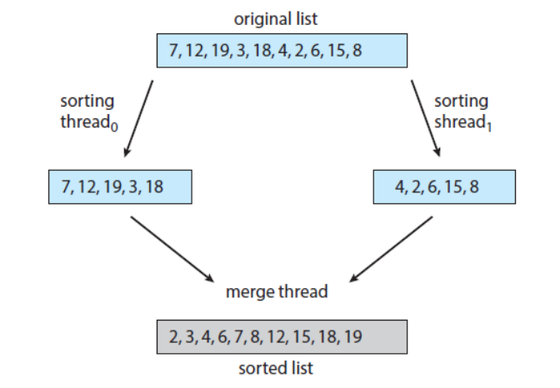
Divide and Conquer Technique
Used in Merge Sort and Quicksort
The problem is divided into smaller subproblems that are similar to the original problem.
The smaller problems are solved using recursion and then the smaller parts are combined to get the ﬁnal solution

Slide 5
Multi-Threading
Multiple threads are created within a process.
All threads are executed independently but concurrently.
The resources of the process are shared between the threads.
If hardware allows, all threads can run fully parallelly if they are distributed to their own CPU cores.
Example: Web Browser
Multiple threads doing diﬀerent tasks
Loading content, playing video, etc.

Slide 6
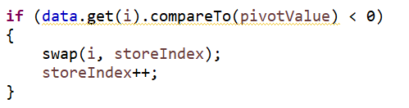
Comparable Interface
Java Comparable interface is used to order the objects of the user-deﬁned class
Only one method named compareTo(Object)
public int compareTo(Object obj): Used to compare the current object with the speciﬁed object. It returns:
positive integer, if the current object is greater than the speciﬁed object.
negative integer, if the current object is less than the speciﬁed object.
zero, if the current object is equal to the speciﬁed object.
We can sort the elements of String objects, Wrapper class objects and User-deﬁned objects.

Slide 7
Fork Join Pool Parallelism API
The fork/join framework has two main classes:
ForkJoinPool
ForkJoinTask
ForkJoinPool- implementation of the interface ExecutorService
Executors provide an easier way to manage concurrent tasks than plain old threads.
We can create our own ForkJoinPool instance using the following constructor:
ForkJoinPool()

Slide 8
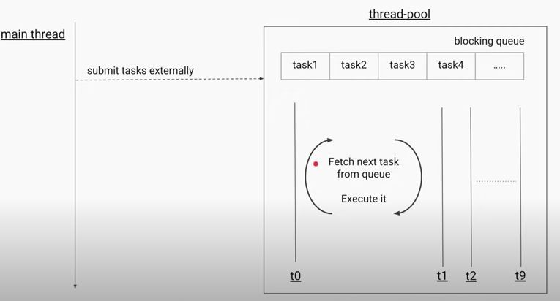
Fork Join Pool Parallelism API
ForkJoinPool forkJoinPool = new ForkJoinPool();
forkJoinPool.invoke(new ListSort<Integer>(list, 0, list.size() - 1));
ForkJoinPool pool = new ForkJoinPool(); pool.invoke(new ListSortq<Integer>(list));

Slide 9
Fork Join Pool Parallelism API
ForkJoinPool class invokes a task of type ForkJoinTask, which can be implemented by extending one of its two subclasses:
RecursiveAction: represents tasks that do not yield a return value, like a Runnable.
RecursiveTask: represents tasks that yield return values, like a Callable
These classes contain the compute() method, which will be responsible for solving the problem directly or by executing the task in parallel.

Slide 10
Fork Join Pool Parallelism API
(Contd.)
Quick Sort:
protected void compute() {
if (left < right){
int pivotIndex = left + ((right - left)/2);
pivotIndex = partition(pivotIndex);
invokeAll(new ListSortq(data, left, pivotIndex-1), new ListSortq(data, pivotIndex+1, right));
}
}
Merge Sort:
protected void compute() {
if (indexStart < indexEnd && (indexEnd - indexStart) >= 1){
int middleElement = (indexEnd + indexStart) / 2;
ListSort<Integer> left = new ListSort<Integer>(arrayToSort, indexStart, middleElement);
ListSort<Integer> right = new ListSort<Integer>(arrayToSort, middleElement + 1, indexEnd);
invokeAll(left, right);
mergeArrayElements(indexStart, middleElement, indexEnd);
}
}

Slide 11
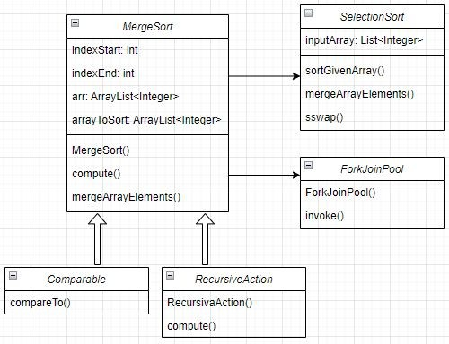
Software Architecture : Merge Sort

Slide 12
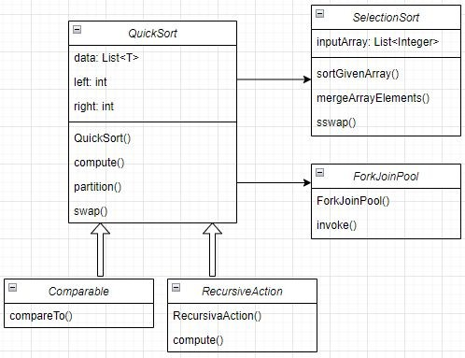
Software Architecture : Quick Sort

Slide 13
Merge Sort Implementation
class ListSort<N extends Comparable> extends RecursiveAction {
int indexStart, indexEnd, arr[];
private final ArrayList<Integer> arrayToSort;
public ListSort(ArrayList<Integer> arrayToSort) { this.arrayToSort = arrayToSort;}
public ListSort(ArrayList<Integer> arr, int low, int high) {
this.arrayToSort = arr; this.indexStart = low; this.indexEnd = high;
}
public ArrayList<Integer> getArrayAfterSorting() { return arrayToSort; }
@Override
protected void compute() {
if (indexStart < indexEnd && (indexEnd - indexStart) >= 1){
int middleElement = (indexEnd + indexStart) / 2;
ListSort<Integer> left = new ListSort<Integer>(arrayToSort, indexStart, middleElement);
ListSort<Integer> right = new ListSort<Integer>(arrayToSort, middleElement + 1, indexEnd);
invokeAll(left, right);
mergeArrayElements(indexStart, middleElement, indexEnd);
}
}

Slide 14
Merge Sort Implementation: Merge Function
// MERGESORT Code
public void mergeArrayElements(int indexStart, int indexMiddle, int indexEnd){
ArrayList<Integer> tempArray = new ArrayList<>();
int getLeftIndex = indexStart, getRightIndex = indexMiddle + 1;
while (getLeftIndex <= indexMiddle && getRightIndex <= indexEnd){
if (arrayToSort.get(getLeftIndex).compareTo((arrayToSort.get(getRightIndex))) <= 0){
tempArray.add(arrayToSort.get(getLeftIndex)); getLeftIndex++;
}
else { tempArray.add(arrayToSort.get(getRightIndex)); getRightIndex++; }
}
while (getLeftIndex <= indexMiddle){
tempArray.add(arrayToSort.get(getLeftIndex)); getLeftIndex++;
}
while (getRightIndex <= indexEnd){
tempArray.add(arrayToSort.get(getRightIndex)); getRightIndex++;
}
for (int i = 0; i < tempArray.size(); indexStart++)
arrayToSort.set(indexStart, tempArray.get(i++));
}
}

Slide 15
Quick Sort Implementation
class ListSortq<T extends Comparable> extends RecursiveAction {
private List<T> data; private int left, right;
public ListSortq(List<T> data){
this.data = data; this.left = 0; this.right = data.size() - 1;
}
public ListSortq(List<T> data, int left, int right){
this.data = data; this.left = left; this.right = right;
}
@Override
protected void compute(){
if (left < right){
int pivotIndex = left + ((right - left)/2);
pivotIndex = partition(pivotIndex);
invokeAll(new ListSortq(data, left, pivotIndex-1), new ListSortq(data, pivotIndex+1, right));
}
}
.

Slide 16
Quick Sort Implementation:
Partition Function
private int partition(int pivotIndex){
T pivotValue = data.get(pivotIndex);
swap(pivotIndex, right);
int storeIndex = left;
for (int i=left; i<right; i++){
if (data.get(i).compareTo(pivotValue) < 0){
swap(i, storeIndex); storeIndex++;
}
}
swap(storeIndex, right);
return storeIndex;
}
private void swap(int i, int j){
if (i != j){
T iValue = data.get(i);
data.set(i, data.get(j));
data.set(j, iValue);
}
}
}
.

Slide 17
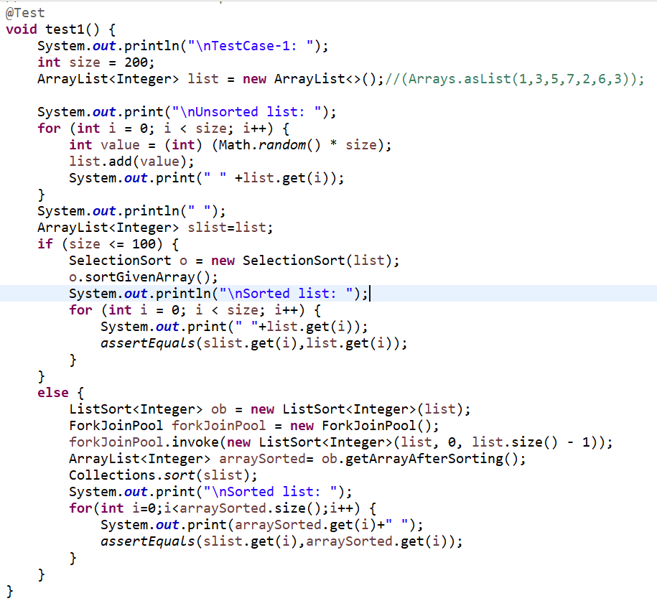
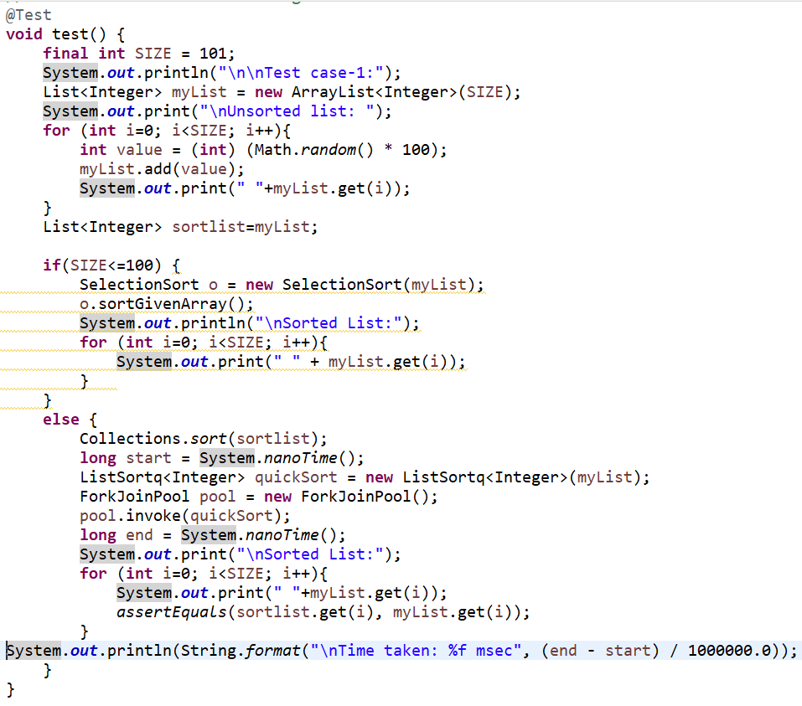
Testing using Junit
For MergeSort Code
For QuickSort Code

Slide 18
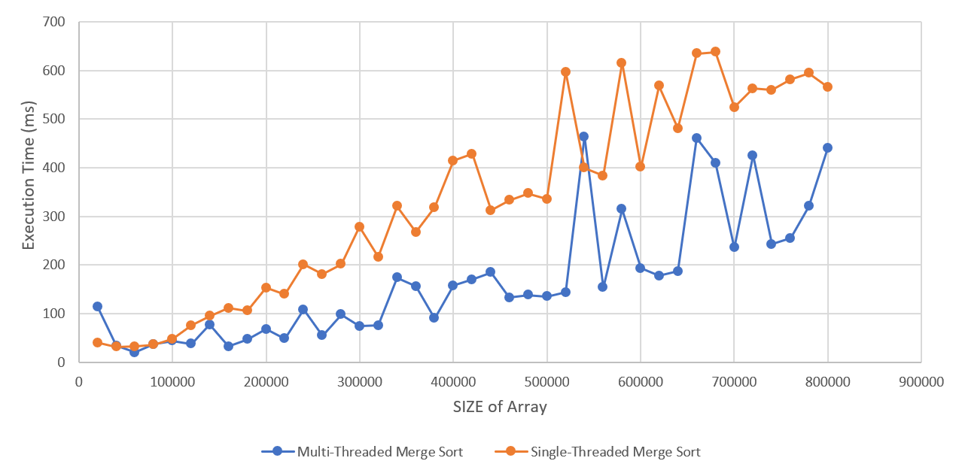
Research work Observations
Execution Time of Multi-Threaded Merge Sorting and Single-Threaded Merge Sorting

Slide 19
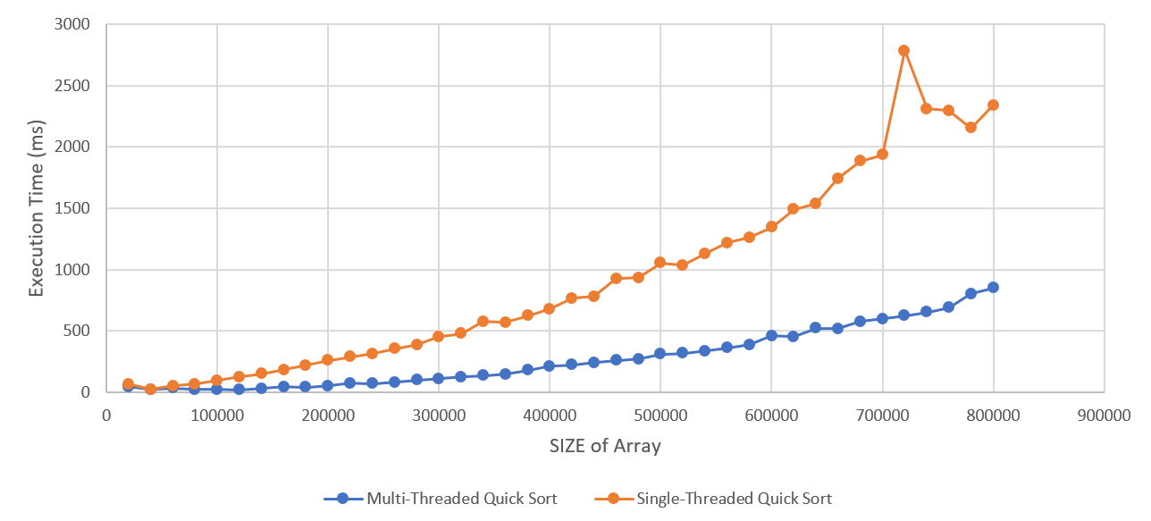
Research work Observations
Execution Time of Multi-Threaded Quick Sorting and Single-Threaded Quick Sorting

Slide 20
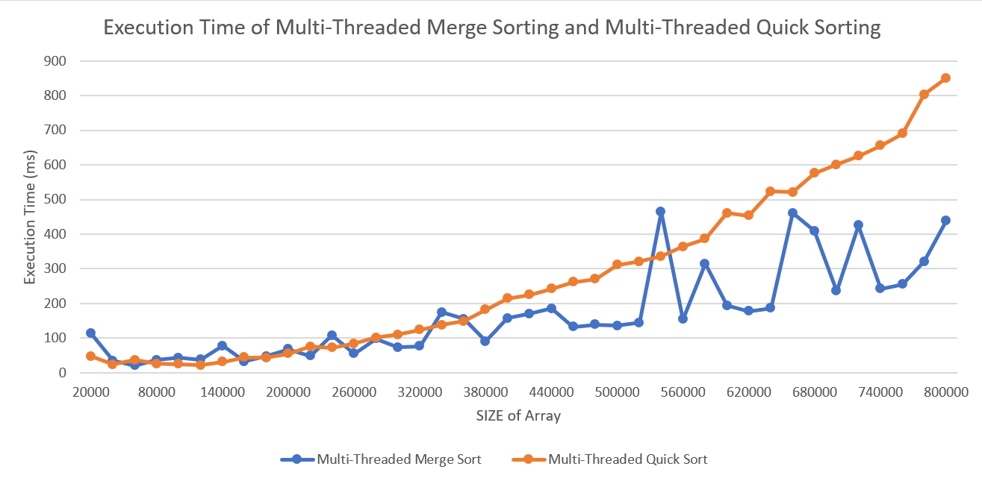
Research work Observations
Execution Time of Multi-Threaded Merge Sorting and Multi-Threaded Quick Sorting

Slide 21
Observations
Multi-Threaded Merge Sorting vs Multi-Threaded Quick Sorting vs
Single-Threaded Merge Sorting vs Single-Threaded Quick Sorting
SIZE of Array | Multi-Threaded Merge Sort (ms) | Multi-Threaded Quick Sort (ms)
20000 | 114.8298 | 47.3909
40000 | 34.5953 | 24.6066
220000 | 48.9163 | 75.7825
240000 | 108.4639 | 72.1381
260000 | 55.0154 | 84.9622
280000 | 98.6903 | 101.44
360000 | 155.9307 | 148.5941
380000 | 90.6427 | 182.4472
580000 | 315.03 | 386.6689
600000 | 193.7055 | 460.4006
660000 | 461.2971 | 520.8313
760000 | 255.2862 | 690.1221
780000 | 320.8397 | 803.5147
800000 | 439.736 | 850.1991
SIZE of Array | Multi-Threaded Merge Sort (ms) | Single-Threaded Merge Sort (ms)
20000 | 114.8298 | 40.5487
40000 | 34.5953 | 32.2591
140000 | 78.0043 | 95.3417
160000 | 32.6125 | 111.4422
180000 | 47.4848 | 105.9981
200000 | 68.1043 | 153.088
340000 | 174.1319 | 320.7811
380000 | 90.6427 | 318.3772
500000 | 135.4561 | 335.8717
620000 | 177.569 | 568.2505
660000 | 461.2971 | 634.7613
740000 | 242.4484 | 559.3338
800000 | 439.736 | 565.9278
SIZE of Array | Multi-Threaded Quick Sort | Single-Threaded Quick Sort
20000 | 47.3909 | 70.478
100000 | 25.4362 | 97.62
120000 | 22.2705 | 127.206
200000 | 55.0626 | 261.164
220000 | 75.7825 | 289.655
300000 | 110.3722 | 454.665
400000 | 214.1448 | 681.1
500000 | 311.572 | 1054.492
600000 | 460.4006 | 1345.69
620000 | 453.6739 | 1490.719
680000 | 576.2991 | 1883.996
700000 | 601.3056 | 1934.513
800000 | 850.1991 | 2339.664

Slide 22
Conclusion
In this Project, we learned the practical implementation of ForkJoinPool & RecursiveAction classes, and also how and where to implement it in real-time issues.
We discovered and compared the execution time taken by MergeSort Algorithm and QuickSort Algorithm to produce results for the problem statement.
The execution time was discovered by performing the tests till 800000 as the size of the list of the algorithms in single-threaded environment as well as multi-threaded environment.
Finally, we found the multi-threaded merge-sort algorithm to be most efficient in execution time comparision.

Slide 23
References
Operating System Concepts (Tenth Edition),
By Abraham Silberschatz, Peter Baer Galvin & Greg Gagne

Slide 24
Thank You

